Slide 1
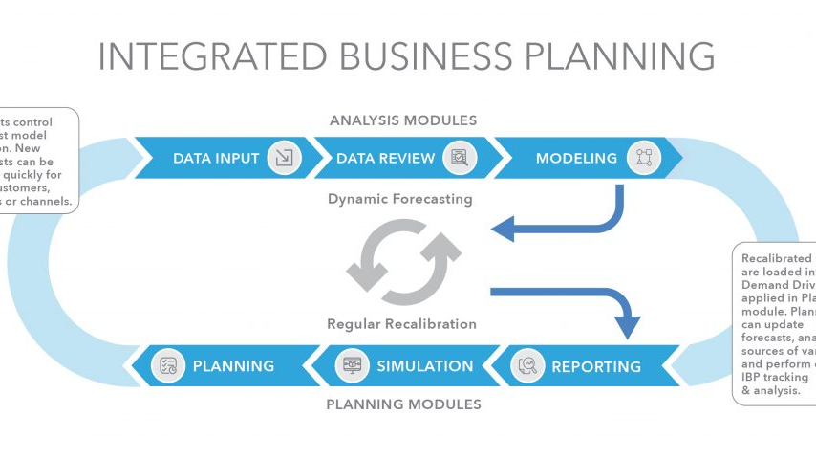
TRAINING MODULE
How to Improve
Forecasting and
Delivery
A Comprehensive Training on N and T Parameters
November 2025

Slide 2
AGENDA
Training Overview
01
Key Points Identification & Analysis
02
How to Input Accurate N and T
Understanding the core challenges in forecasting and delivery processes
Mastering product list accuracy and time parameter management
03
Sales Forecasting Process
04
Project & Supply Chain Coordination
Order commitments and delivery planning in forecasting workflows
Collaboration between approved projects, general projects, and supply chain
Training Objective
Target Audience
Enhance forecasting accuracy and delivery efficiency through systematic training on N and T parameters
Sales teams, pre-sales engineers, and supply chain professionals involved in forecasting processes

Slide 3
FOUNDATIONAL CONCEPTS
Four Core Points for Forecasting & Delivery
1
Accuracy of N and T Parameters
Accurate N (product list) and T (time parameters) directly impact three critical business functions: sales forecasting, supply chain preparation, and order delivery processes. Inaccurate inputs create cascading failures across the entire fulfillment cycle.
2
Beyond Order Commitment
To better support backend preparation and delivery, sales forecasting must manage not only order commitments but also delivery timing requirements . Both dimensions are essential for synchronized operations.
3
Supply Chain Support
Supply chain support for front-end sales projects plays a crucial role in both preparation and delivery. Early engagement and collaboration ensure that forecasted demands align with operational capabilities and inventory strategies.
4
Channel Communication
Forecasted order and delivery timing must be promptly communicated and confirmed with channels. This ensures that front-end commitments remain synchronized with back-end execution, preventing costly mismatches.
Key Insight: These four points are interdependent. Success requires coordinated effort across sales, pre-sales, supply chain, and channel partners.

Slide 4
PARAMETER N
Understanding N: Definition & Key Factors
What is N?
Funnel Entry Decision Flow
N represents the Product List — the definitive expression of customer requirements. Making N accurate means ensuring the product list is precise and aligned with actual needs.
Is Product Series Clear?
Condition 1: Accurate Configuration
Product list must be accurately configured to match customer needs, following PMF strategy
Condition 2: Timely CRM Updates
YES → Proceed
NO → Stop
Product list must be promptly updated in the CRM system for system-wide visibility
Two Business Scenarios
Enter Funnel
1. Entering Funnel
When project moves from outside to inside funnel, product series must be clearly defined; otherwise, funnel entry is not permitted
Key Benefits
Improves overall funnel quality
Strengthens product sales forecasting
2. Funnel Management
Accurately reflects market demand
For funnel projects, forecast category and days to bid opening determine credibility requirements. Lists below threshold must be improved within specified timeframe
Ownership
Primary: Pre-sales
Support: Sales (CRM updates)

Slide 5
CREDIBILITY ASSESSMENT
N Credibility: Four Standards & Two Business Types
Two Business Processes
1
Self-Assessment Scoring
2
Funnel Entry Criteria
Process 1: Funnel Entry
Pre-sales evaluates product lists using weighted criteria across four dimensions
Minimum requirements for projects entering the funnel: Budget ≥3 AND Product Series ≥3
Projects moving from outside to inside funnel
Process 2: Funnel Management
Used in: Both processes
Used in: Process 1 only
Ongoing management of existing funnel projects
3
Forecast Category Thresholds
4
Bid Timeline Requirements
Framework Benefits
Different credibility requirements based on prediction category: Possible- (24%), Possible+ (60%), Advantaged (80%)
Within 30 days of bid opening: Non-weak current/ICT (100%), Weak current/ICT (65%)
Standardized evaluation criteria
Objective quality measurement
Proactive issue identification
Used in: Process 2
Used in: Process 2
Implementation Note: These four standards work together to ensure product list quality throughout the project lifecycle, from initial entry to ongoing management.

Slide 6
STANDARD 1
Self-Assessment Scoring Criteria
Category | Weight | Score | Result | Scoring Criteria (5-Point System)
Project Budget | 20% | 3 | 0.6 | 5: Confirmed budget &amp; pricing strategy 4: Clear budget 3: Estimable budget
Technical Route | 20% | 3 | 0.6 | 5: All series confirmable (in tender doc) 4: 80%+ series confirmable (decision made) 3: 50%+ series confirmable (our recommendation)
Product Model | 30% | 3 | 0.9 | 5: All models confirmable (specs in tender) 4: 80%+ models confirmable 3: 50%+ models confirmable
Performance/Quantity | 30% | 3 | 0.9 | 5: All quantities confirmed (in tender) 4: 80%+ quantities confirmed 3: 50%+ quantities confirmed
Total Credibility Score
Scoring System
Key Notes
60%
5: Fully confirmed
• Product series defined by configurator
4: 80%+ certain
• Sales judgment for budget
Minimum for funnel entry
3: 50%+ certain
• Technical specs in tender docs = highest certainty
0: Below 50%

Slide 7
STANDARDS 2-4
Funnel Entry & Forecast Thresholds
2
Standard 2: Funnel Entry Criteria
When entering the funnel, pre-sales conducts self-assessment. The product list can only be shared with sales when both "Budget Amount" and "Product Series" score ≥3 points. Sales can then import the shared list (which carries the credibility score) and submit the funnel application.
≥3
≥3
Budget Amount
Product Series
3
Standard 3: Forecast Category Thresholds
4
Standard 4: Bid Timeline Requirements
Different forecast categories require different levels of credibility:
When bid opening is within 30 days, credibility requirements vary by project type:
Possible-
24%
Non-Weak Current & ICT
100%
Full certainty required due to tight timeline
Possible+
60%
Advantaged
80%
Lower threshold accounting for project complexity
Weak Current & EPC
65%

Slide 8
PARAMETER T
Understanding 3T: Critical Time Parameters
T1
T2
T3
Required Delivery Time
Estimated Order Date
Estimated Bid Date
The time when customer requires goods on site (not just our company, but for the entire project). Calculated by working backward from go-live date.
Calculated as: Required Delivery Time minus SLA (order processing lead time in ERP system)
Varies by project type (see details in next section)
Applies to: All projects
Applies to: All projects
Applies to: Specific project types
Estimated Bid Date (T3) by Project Type
Government/Standard Procurement
Weak Current & EPC
Date of bid announcement or notification (not bidding date)
Contract signing date with us or our agent
ICT & Investment/Financing
Framework OC Sub-projects
Contract signing with investor or designated financing channel
PO (Purchase Order) generation time
Key Principle
Critical Note
T1 drives T2: Required Delivery Time (T1) minus SLA determines Estimated Order Date (T2). Accurate T1 is critical for the entire timeline.
"Required Delivery Time" is no longer strongly tied to "Stock-up or Not" — it's for planning, not commitment.

Slide 9
T1 ESTIMATION
Required Delivery Time: Estimation Methods
Two Estimation Scenarios
Filling Examples
1
Example 1: No Extensive Cabling
Scenario 1: No Extensive Cabling
"Confirmed with client's IT Director: project go-live Sep 30. No extensive cabling. 15-day lead time gives Sep 15 Required Delivery Time, confirmed feasible."
For projects not requiring extensive cabling work, calculate backward from go-live date:
Go-Live Date − 15 Days
Example 2: Extensive Cabling
"Confirmed with PM: go-live Sep 30. Extensive cabling needed. 30-day lead time gives Sep 1 Required Delivery Time, confirmed feasible."
2
Scenario 2: Extensive Cabling
For projects involving extensive cabling work, allow longer lead time:
Go-Live Date − 30 Days
Example 3: Urgent/Flow Projects
Fill based on actual situation. Maintain close communication with supply chain for coordination.
Critical Success Factor
Important Note
Sales must proactively communicate with customers/channels to confirm final go-live time and construction cycle, updating "Required Delivery Time" in CRM promptly.
Sales must fill "Required Delivery Time" AND explain basis in "Stock-up Notes" field; otherwise, the date cannot be submitted.

Slide 10
T2 & T3 CALCULATION
Estimated Order & Bid Time: Methods
T2: Estimated Order Date Calculation
For all projects, Estimated Order Date = Required Delivery Time (T1) − SLA
Multi-Product Orders
Example
Quality Check
If products have different SLAs, use the maximum SLA value
Products A (3d), B (7d), C (14d) → Order SLA = 14 days
Entered date must be ≥ SLA-calculated date
T3: Forward Method
T3: Backward Method
Formula: Current Time + Customer Procurement Cycles
Formula: Customer Required Delivery − Key Activity Durations
Application Steps
Deduction Items
1. Identify current project stage
• Contract signing and order processing cycle
2. Map customer procurement process steps
• Project complexity buffer time
3. Estimate duration for each step
• Customer internal approval periods
4. Sum all procurement cycle times
• Buffer for potential delays
5. Add to current date for estimated bid date
Best for: Early-stage projects
Best for: Projects with fixed delivery dates
Guidance: Use Forward Method as primary, Backward Method as validation. Combining both improves accuracy.

Slide 11
WORKFLOW MANAGEMENT
Business Processes: Funnel Entry & Management
1
Process 1: Funnel Entry
2
Process 2: Funnel Management
Step 1: Configure List
Daily Self-Check
Role: Pre-sales | Configures product list, completes credibility self-assessment, shares if达标
Regular monitoring of product list credibility
If not meet standard: Daily email alerts; 30-day window to improve
Step 2: Import List
Upgrade Forecast Category
Role: Sales | Imports latest shared list (auto-verified), saves to CRM
When upgrading (e.g., Possible+ to Advantaged)
System checks credibility; 30-day compliance
Step 3: Submit Application
Update Bid Timeline
Role: Sales | CRM auto-checks credibility; blocks if below threshold
When bid opening date changes
Step 4: Approve Funnel
System checks against Standard 4; 7-day compliance
Role: Regional Manager | Reviews application and credibility score
Common Follow-up Actions
• Pre-sales updates and shares list
Step 5: Calibrate List
• Sales updates CRM system
Role: Pre-sales | Verifies consistency across systems
• Pre-sales calibrates for accuracy
Process 1 Key Control
Process 2 Key Control
Success Factor
System-enforced credibility check
Automated alerts & time-bound compliance
Collaboration & system enforcement

Slide 12

TRAINING SUMMARY
Key Takeaways
& Next Steps
1
Accuracy is Foundation
2
Credibility Ensures Quality
Accurate N and T input is the cornerstone of supply chain efficiency. Quality inputs drive quality outputs.
The four-standard credibility framework ensures forecast quality and enables continuous improvement.
3
Communication is Essential
4
Continuous Monitoring
Proactive communication with channels and customers prevents mismatches and ensures alignment.
Regular updates and calibration maintain forecast accuracy throughout the project lifecycle.
Call to Action
Implement these practices in your daily work. Collaborate closely with Sales, Pre-sales, and Supply Chain teams. Leverage the credibility framework and automated alerts to maintain high forecast quality and drive operational excellence.
Questions?
Contact Supply Chain Team

